Slide 1

Go Phish:
Visualizing Basic Malice
Threat Hunting: Kill Chain 1
SamunoskeX

Slide 2
whoami
SamunoskeX
A tinkerer
A SOC Team Member
A Blue Team enthusiast
An instructor
A student

Slide 3
What will we be learning today?
What is phishing and what is a phishing payload?
What is Visual Basic for Applications?
What are Macros and what does this have to do with phishing and Threat Hunting?
How can we walk through the thought process associated with a Threat Hunt from hypothesis to tangible results?
What tools do we have at our disposal and what can we do with them?

Slide 4
Phishing… Is that a thing still?
Phishing is still one of the most common attack methods in use.
But what IS phishing?
What is a phishing payload?
What are the differences between types of payloads?

Slide 5
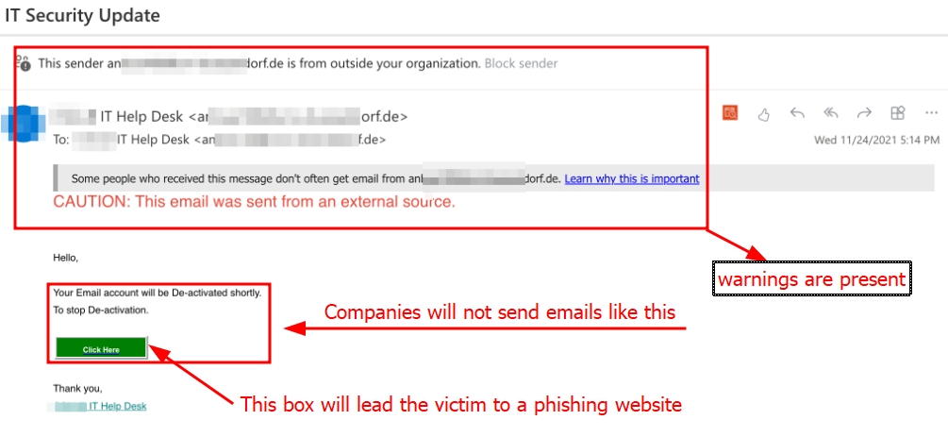
Phishing… Is that a thing still?
Some examples of Phishing Payloads:

Slide 6
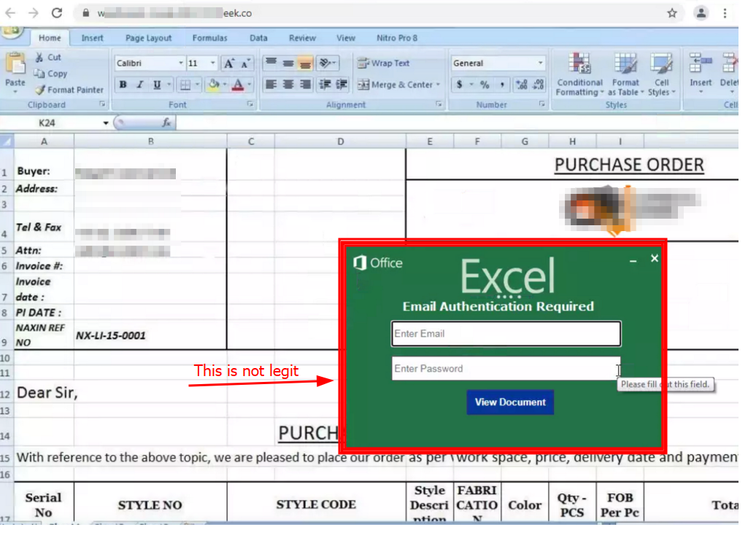
Phishing… Is that a thing still?
Some examples of Phishing Payloads:

Slide 7
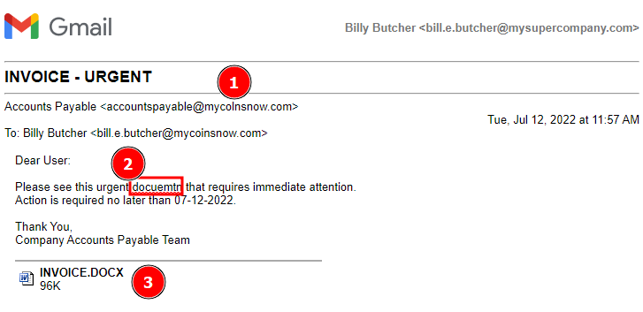
Phishing… Is that a thing still?
Some examples of Phishing Payloads:

Slide 8
Visual Basic for Applications?
Visual Basic for Applications (VBA)
Microsoft’s generous gift for extensibility in Office
Allows for adding functionality in Word, PowerPoint, Excel
Commonly referred to as Macros
Is not limited in scope to just the Office applications.
This can be a rather large concern.
Weaponized by adversaries.

Slide 9
Macro use in Phishing Attacks
Macros can perform actions automatically and without obvious signs just by opening a document/file that contains active macros.
What are the implications?
What does a macro look like?

Slide 10
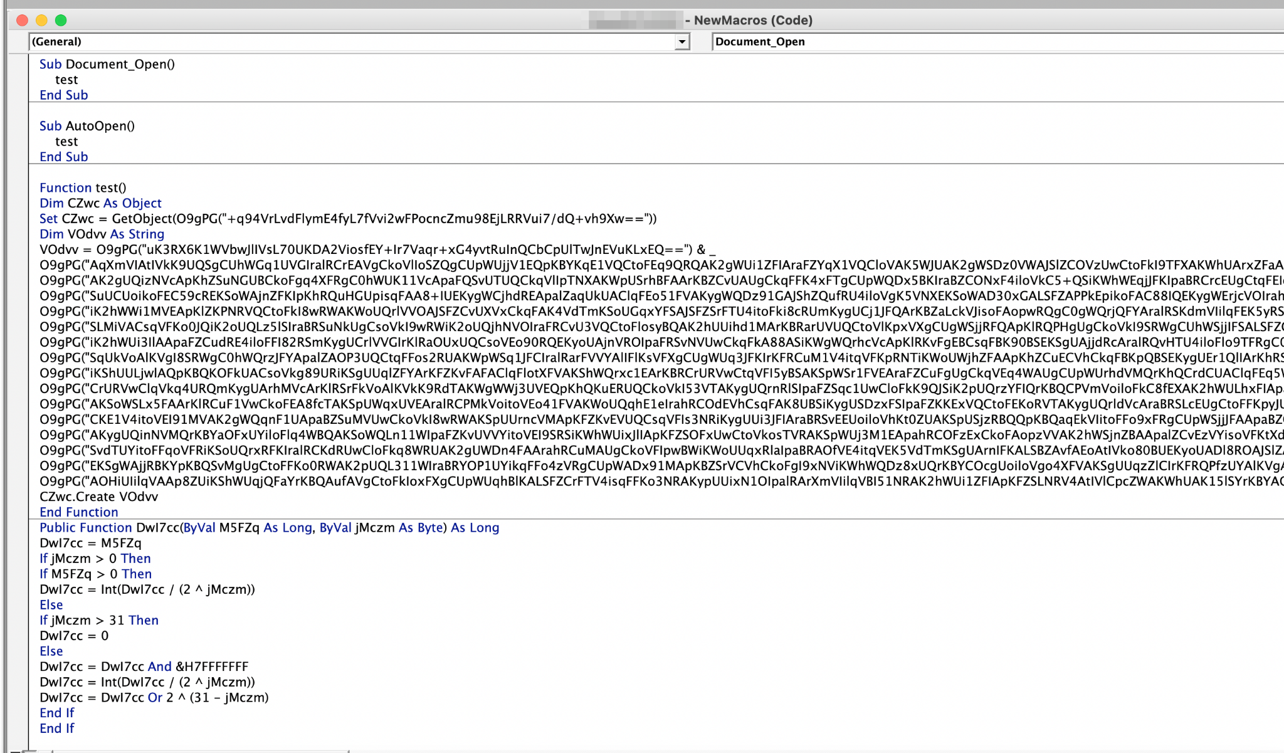
Macro use in Phishing Attacks

Slide 11
What’s the scenario?
I’m a new member of the Magnum Tempus (MT) Security Team.
I have been asked to build a Threat Hunt (TH) based on what I think might be missed in the environment.
I’ve never done a Threat Hunt. Where do I start?

Slide 12
What’s your hypothesis?
All Threat Hunts need to start with a hypothesis in mind.
Focus on macro use in the environment.
I start with a broad hypothesis:
Magnum Tempus employees receive malicious emails.
This is a good starting point, but it far too broad.
Refining the hypothesis a bit better, we come up with:
MT Employees are targeted with Malicious Microsoft Documents containing VBA macros via phishing email. Some employees will click and open malicious documents.

Slide 13
IMPORTANT NOTE!
A lot of what we’re going to be doing here are queries specific to the Splunk query language.
The concepts of the Threat Hunt can be adapted to any query language/log platform.
There are also online applications that can convert the query syntax from one language to another language, but we will not be discussing that here.

Slide 14
Let’s Start the Hunt!
We need to start with a query in Splunk, but we need to know the data sources we have available.
We could start by searching across all data within the query:
index=”*”
This is bad practice and a great way to get server admins mad at you. We might want to use a query to see what indexes we have available:
| eventcount summarize=false index=* | dedup index | fields index
The above query narrows down to just the log data sources

Slide 15
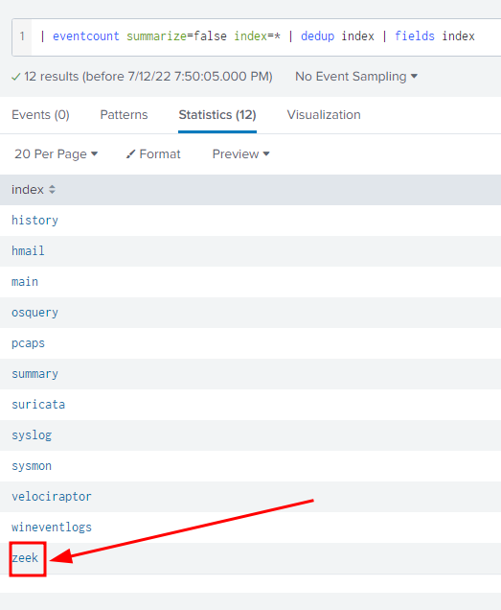
Let’s Start the Hunt!

Slide 16
Let’s Start the Hunt!
Start with Zeek, since we can see files transmitted over the network:
index=”zeek”
We need to set a date range for the data we’re looking through.
For this example, we are using 2022-02-11 through 2022-02-13
We already know that Microsoft Office Documents are used for the macro behavior.
This includes .doc, .docx, .xls, .xlsx
We need to modify our search:
index=”zeek” (.doc OR .docx OR .xls OR .xlsx)

Slide 17
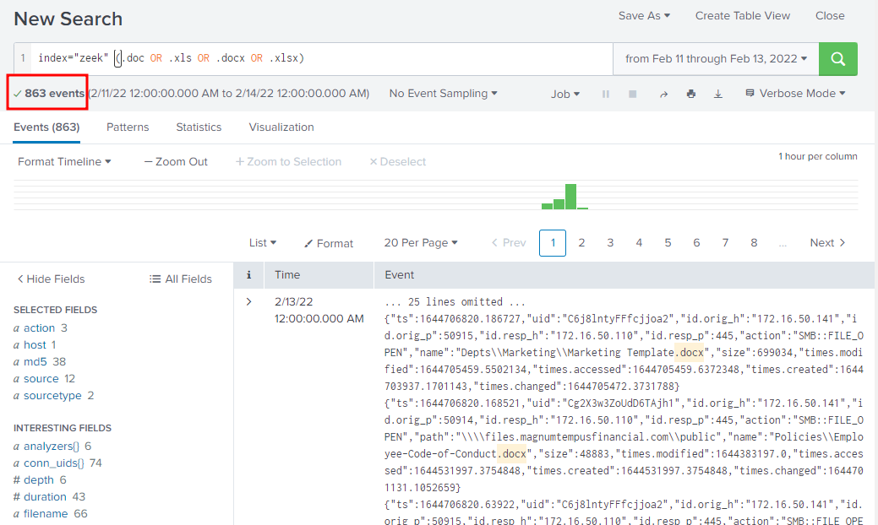

Slide 18
What did we find?
This search yielded a lot of events. We probably can narrow down more:
index=”zeek” (.doc OR .docx OR .xls OR .xlsx)
This is probably a great point to bring something up that is integral for Threat Hunting…

Slide 19

A Note about Note-Taking during the Threat Hunting process
Pro Tip:
During, and throughout the Threat Hunting process, one should take good notes.
Image Source: https://www.pexels.com/photo/black-laptop-computer-beside-white-steno-notebook-2034373/
Notes:
\

Slide 20
What did we find?
This search yielded a lot of events. We probably can narrow down more:
index=”zeek” (.doc OR .docx OR .xls OR .xlsx)
How can we refine this search?
Since we’re focusing on supposed phishing emails, we can look into adding common terms used in phishing documents. SANS has a pretty extensive list available for us: https://isc.sans.edu/forums/diary/Common+Patterns+Used+in+Phishing+Campaigns+Files/23403/

Slide 21
Using Terms to Fine Tune
Let’s add some terms from the list at SANS:
index=”zeek” (.doc OR .docx OR .xls OR .xlsx) (invoice OR remit OR payment OR order)
Let’s also use another index, this time using sysmon.
index IN (zeek, sysmon) (.doc OR .docx OR .xls OR .xlsx) (invoice OR remit OR payment OR order)

Slide 22
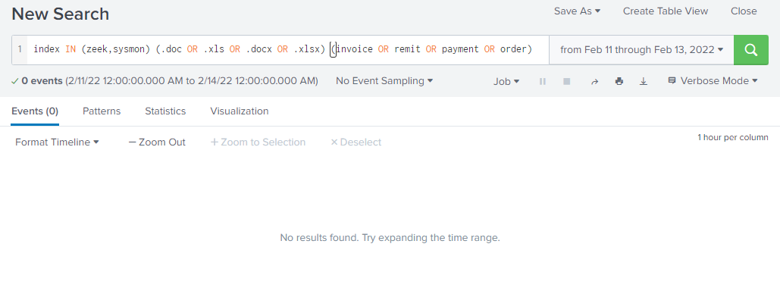
Using Terms to Fine Tune
This did not get us any results that are beneficial:

Slide 23

What can we do to get better results?
Image Source: https://commons.wikimedia.org/wiki/File:Question_Mark_Icon.png

Slide 24
Check our Notes
Image Source: https://www.pexels.com/photo/black-laptop-computer-beside-white-steno-notebook-2034373/
Notes:
Welllllll …… Looking at our NOTES, we see that…

Slide 25
What are we looking for?
Remember, we’re looking for VBA/Macro evidence tied to Office Documents obtained via email.
Is there a way for us to determine (via logs) that a macro has executed?
There is! https://isc.sans.edu/diary/Office+macro+execution+evidence/27244
According to SANS, we can look for something called “TrustRecords” that indicates macro execution.

Slide 26
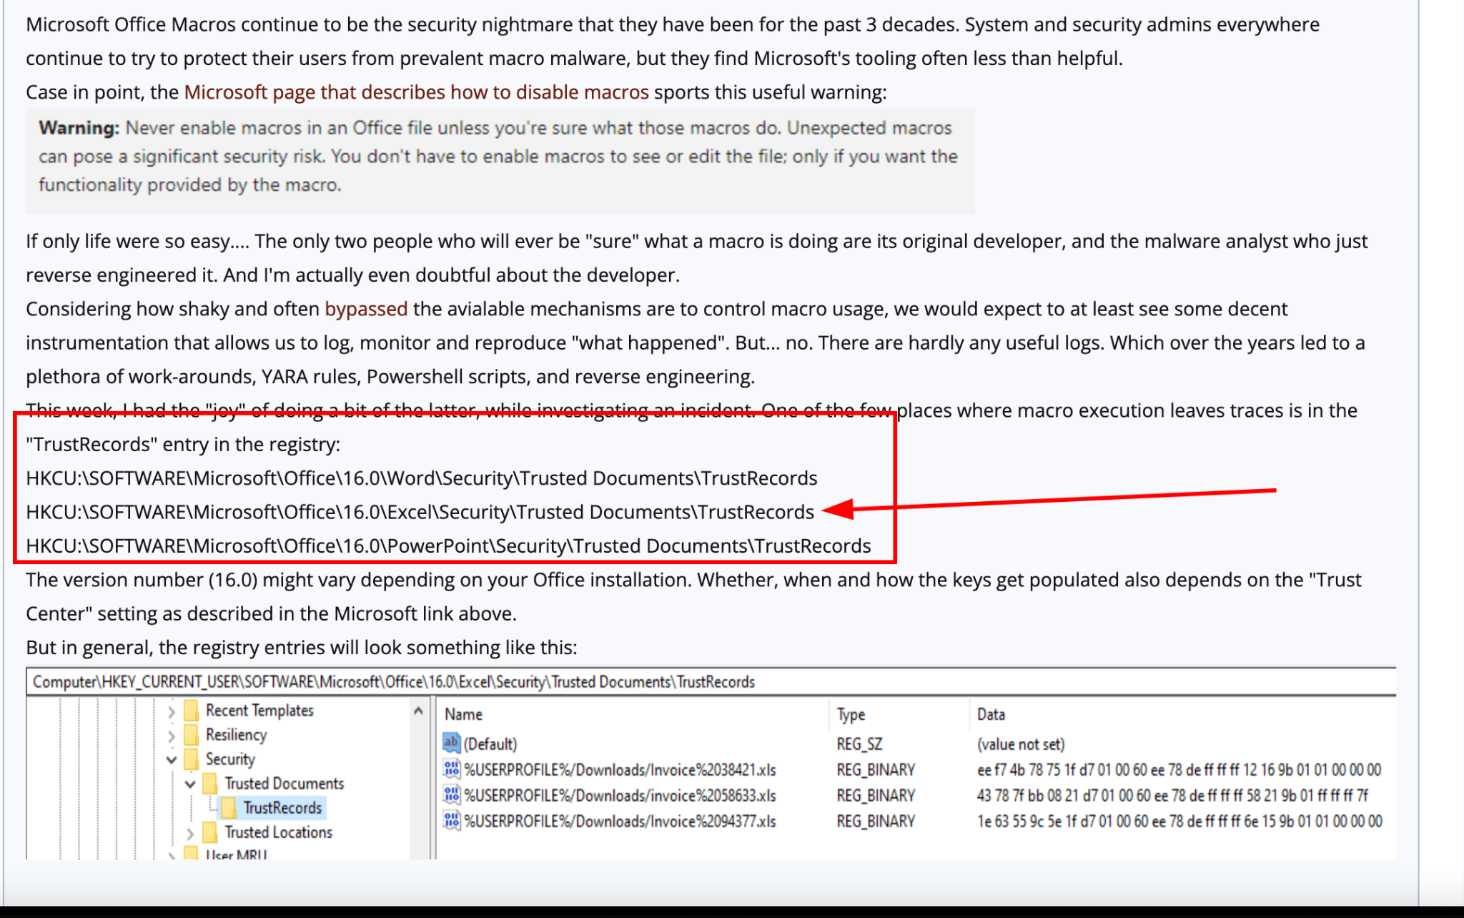
What are we looking for?
Image Source: https://isc.sans.edu/diary/Office+macro+execution+evidence/27244

Slide 27
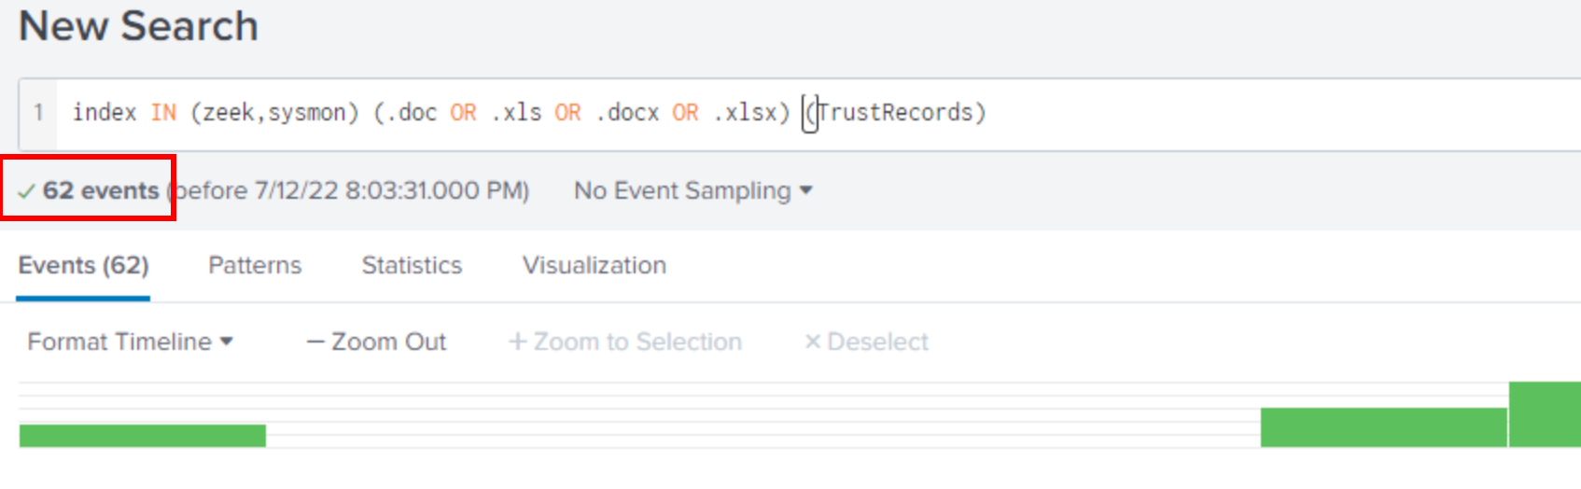
Let’s find TrustRecords!
Knowing that “TrustRecords” indicates macro execution, let’s craft our new query:
index IN (zeek,sysmon) (.doc OR .xls OR .docx OR .xlsx) (TrustRecords)

Slide 28
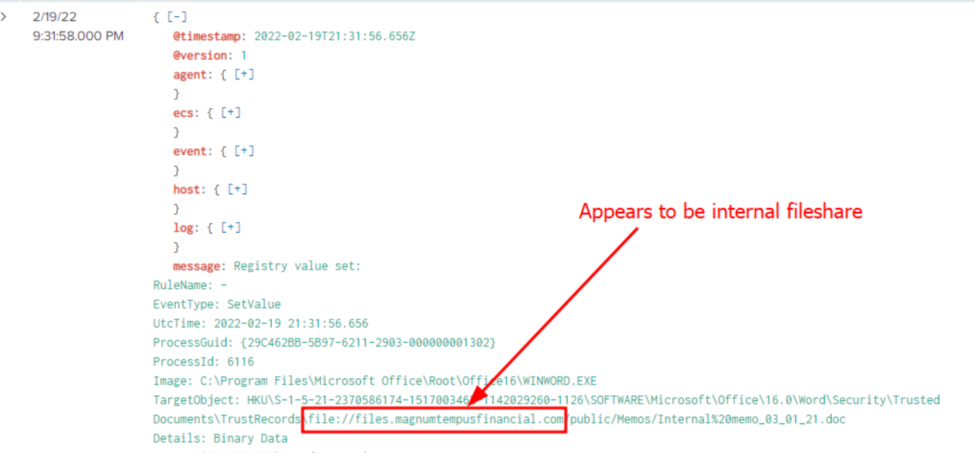
Let’s find TrustRecords!
Let’s take a look at the first event we find:

Slide 29
What is the significance?
This appears to be a company file share. We are looking for documents downloaded by a user via email.
We wouldn’t likely see the documents on a file share initially.
We would, however, expect to see this on the user’s system.
Let’s take a quick look at how many of the 62 events are located on the Magnum Tempus fileshare:
index IN (zeek,sysmon) (.doc OR .xls OR .docx OR .xlsx) (TrustRecords) AND (files.magnumtempusfinancial.com)
Notes:
index IN (zeek,sysmon) (.doc OR .xls OR .docx OR .xlsx) (TrustRecords) AND (files.magnumtempusfinancial.com)

Slide 30
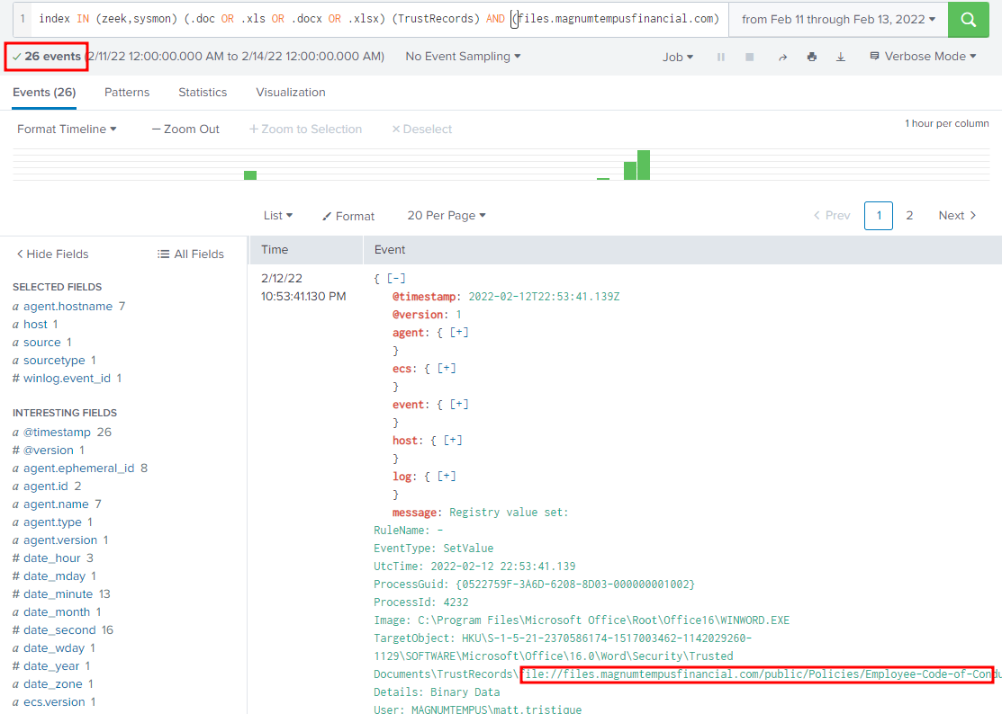
What is the significance?
From this query, we see 26 events associated with the files share:

Slide 31
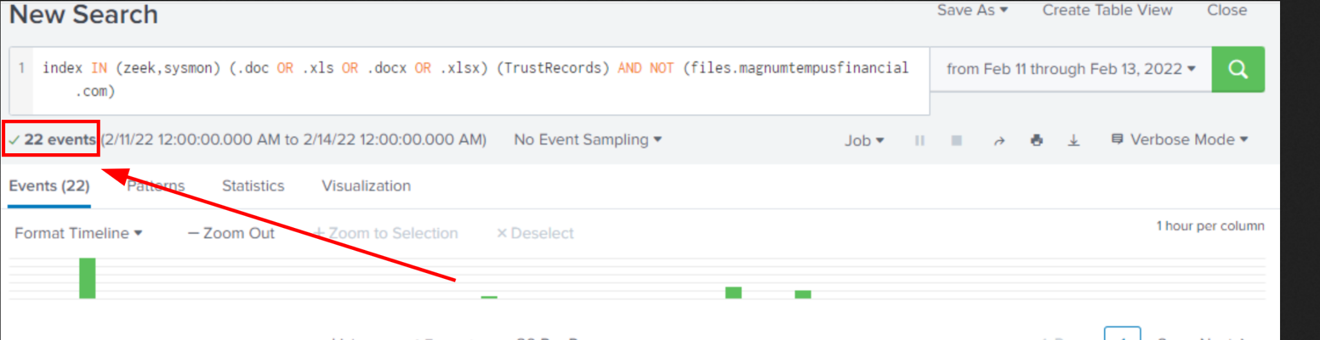
What is the significance?
Let’s run the inverse query, removing the file share events from our results:
index IN (zeek,sysmon) (.doc OR .xls OR .docx OR .xlsx) (TrustRecords) AND NOT (files.magnumtempusfinancial.com)
Notes:
index IN (zeek,sysmon) (.doc OR .xls OR .docx OR .xlsx) (TrustRecords) AND NOT (files.magnumtempusfinancial.com)

Slide 32
Are we done?
Image Source: https://commons.wikimedia.org/wiki/File:Question_Mark_Icon.png

Slide 33
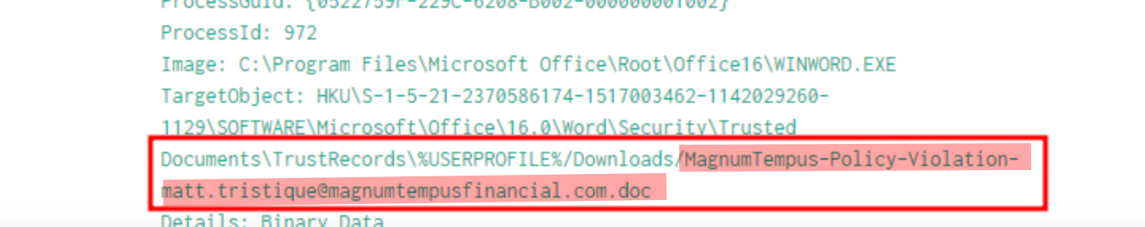
New Results
From this new query, we see 22 events associated. Looking at the very first one, we can see something that stands out:

Slide 34
Why does this stand out?
The naming convention of the file is odd - why would an organization use an email address in the filename:
MagnumTempus-Policy-Violation-matt.tristique@magnumtempusfinancial.com.doc
The location indicates the file was downloaded.
The event indicates that the TrustRecords section was triggered for this file.

Slide 35
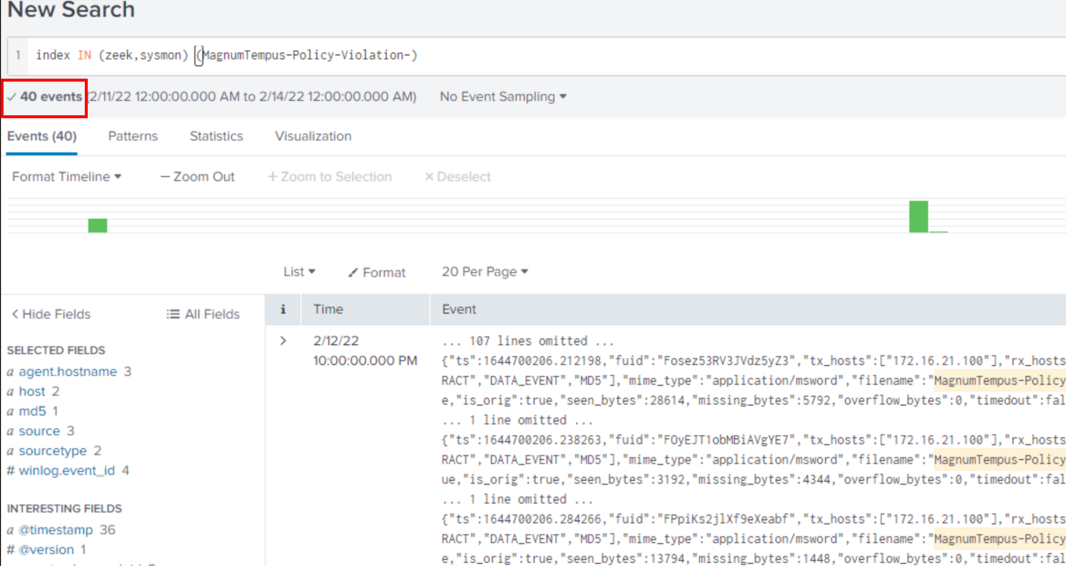
Can we find similar files?
Let’s refine our query, knowing the filename of what we suspect may be a malicious file:
index IN (zeek,sysmon) (MagnumTempus-Policy-Violation-)
Notes:
index IN (zeek,sysmon) (MagnumTempus-Policy-Violation-)

Slide 36
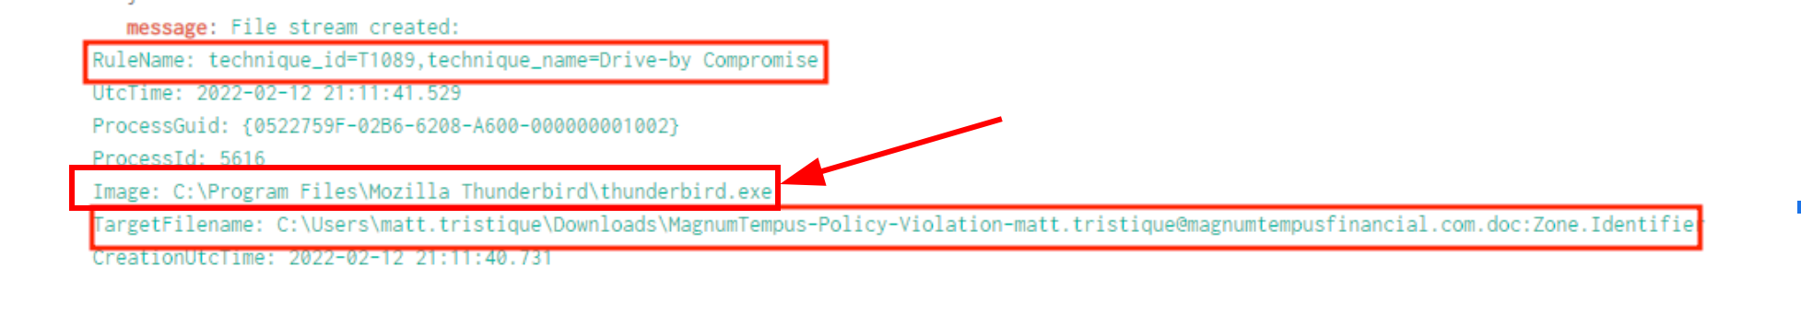
What does this mean?
We have 40 events available to us, let’s scroll a bit. The first event appears to have not been parsed properly. Let’s note this for our findings.
Another example can be seen:

Slide 37
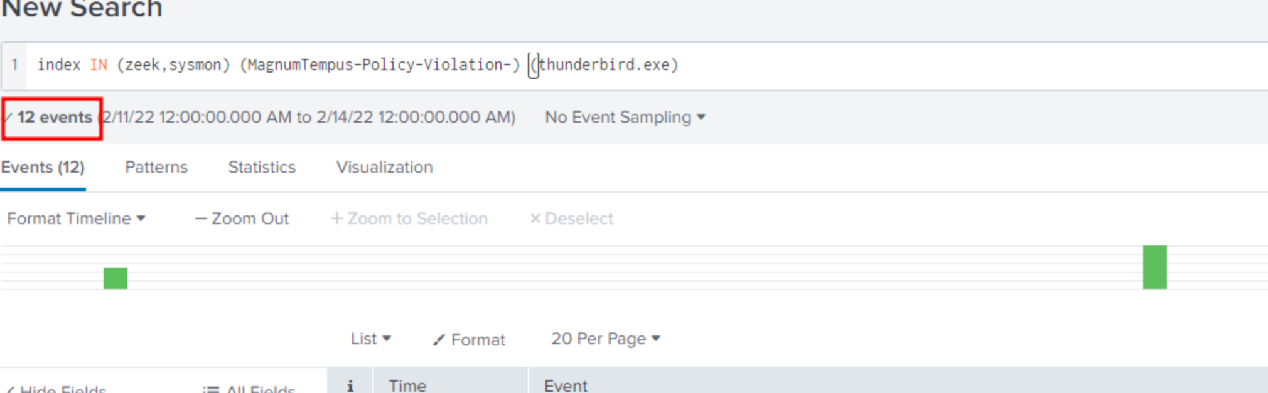
Can we refine this query?
Based on the log data we see, it appears that Thunderbird is the Mail Client of choice at Magnum Tempus. Let’s use this to our advantage:
index IN (zeek,sysmon) (MagnumTempus-Policy-Violation-) (thunderbird.exe)
Notes:
index IN (zeek,sysmon) (MagnumTempus-Policy-Violation-) (thunderbird.exe)

Slide 38
What did we uncover?
With our previous query, we see we have 12 entries. Scrolling these we see two additional users downloaded this file:
File created: RuleName: - UtcTime: 2022-02-12 21:11:24.552 ProcessGuid: {29C462BB-0EC0-6208-D000-000000001202} ProcessId: 3184 Image: C:\Program Files\Mozilla Thunderbird\thunderbird.exe TargetFilename: C:\Users\amanda.nuensis\Desktop\MagnumTempus-Policy-Violation-amanda.nuensis@magnumtempusfinancial.com.doc CreationUtcTime: 2022-02-12 21:11:24.552 User: MAGNUMTEMPUS\amanda.nuensis
File created: RuleName: - UtcTime: 2022-02-11 04:51:45.698 ProcessGuid: {444CBE19-EAF9-6205-E600-000000001302} ProcessId: 5552 Image: C:\Program Files\Mozilla Thunderbird\thunderbird.exe TargetFilename: C:\Users\karen.metuens\Desktop\MagnumTempus-Policy-Violation-karen.metuens@magnumtempusfinancial.com.doc CreationUtcTime: 2022-02-11 04:51:45.572 User: MAGNUMTEMPUS\karen.metuens

Slide 39
What does this mean?
At this point, we have validated our hypothesis that a Microsoft Office file was downloaded from email by end users that contained Visual Basic for Application Macros.
Are we done?
Possibly.
If you’re like me, you might be interested to dig deeper to see if you can find more information about these files.

Slide 40
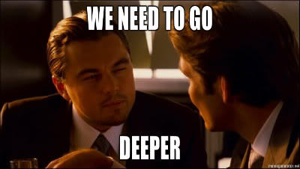
What does this mean?
Image Source: https://knowyourmeme.com/memes/we-need-to-go-deeper

Slide 41
What’s next?
Image Source: https://commons.wikimedia.org/wiki/File:Question_Mark_Icon.png

Slide 42
What’s Next?
We also have access to the Packet Capture for network traffic. We commonly call this captured file a “PCAP” file.
A common tool used to browse/hunt in a PCAP file is called WireShark. Let’s load up WireShark with the appropriate PCAP and see what we can find.

Slide 43
WireShark
Once we load the PCAP, we can start searching for some information we located in our initial Hunt.
Remembering that we found a filename that was sent/downloaded by multiple users:
MagnumTempus-Policy-Violation-amanda.nuensis@magnumtempusfinancial.com.doc
Let’s not include “MagnumTempus” in any search to reduce false positive discoveries.
Since “Policy-Violation-” appears and could potentially be very unique, we will proceed with searching for this term in Wireshark.

Slide 44
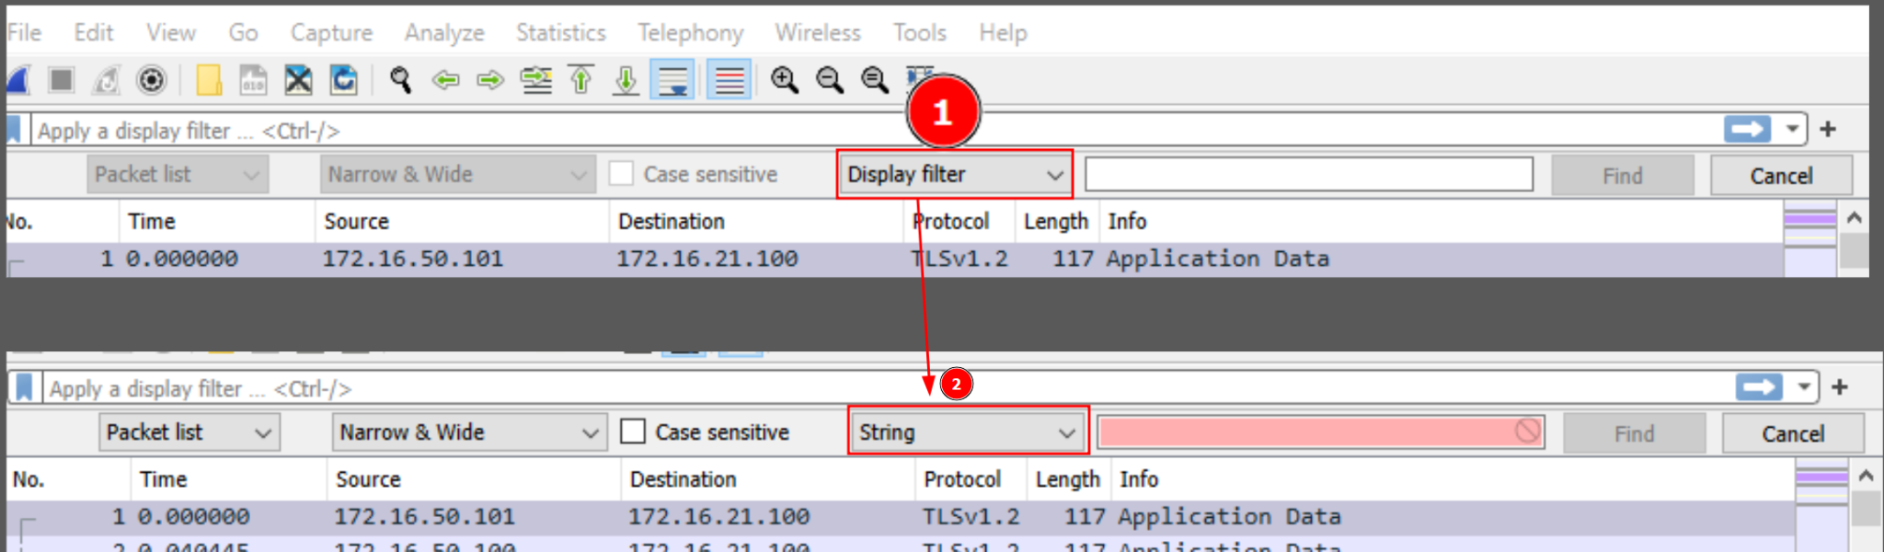
WireShark
Let’s enable the search functionality by pressing Ctrl+F, then choose “String” as shown here in Display filter (1):

Slide 45
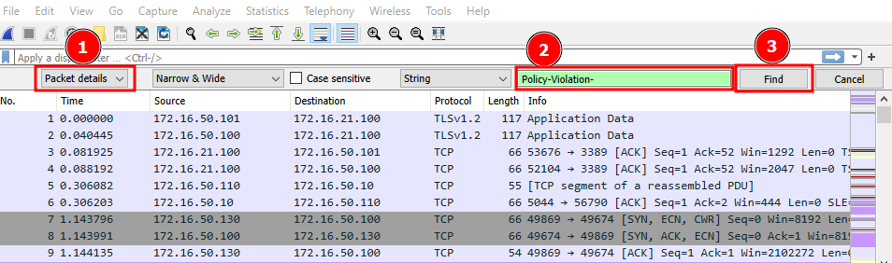
WireShark
First, we need to change to search “Packet Details” as shown in #1
Next, we put in “Policy-Violation-” in the green area shown in #2 (note it will be red at first) and then press “Find” as shown in #3:

Slide 46
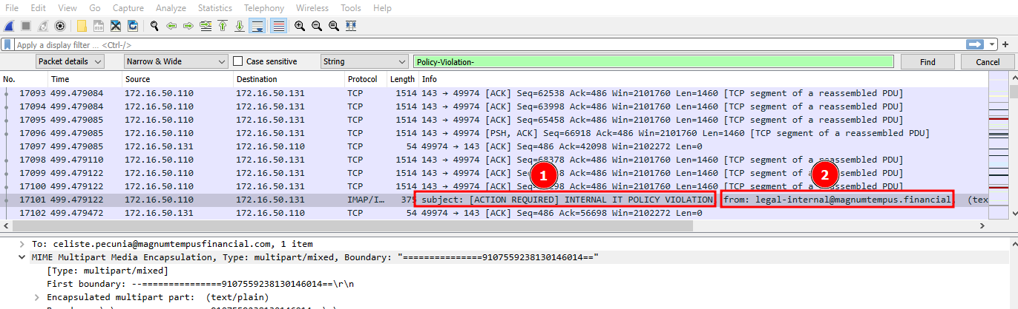
WireShark
This might take a while, but we eventually see the subject line as shown in #1 and the sender in #2:
Subject: [ACTION REQUIRED] INTERNAL IT POLICY VIOLATION
From: legal-internal@magnumtempus.financial

Slide 47
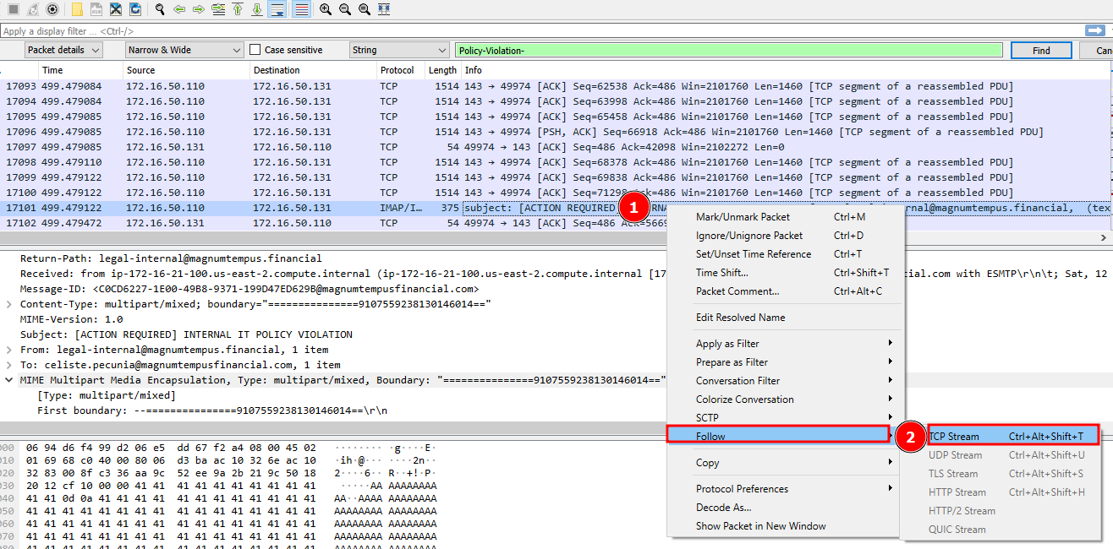
WireShark
Let’s see what more we can uncover. Right click on the packet seen at #1, then hover over “Follow” then click on TCP Stream. This will give us a single view of all of the packets in that stream. This can also be accomplished by using Ctrl+Alt+Shift+T

Slide 48
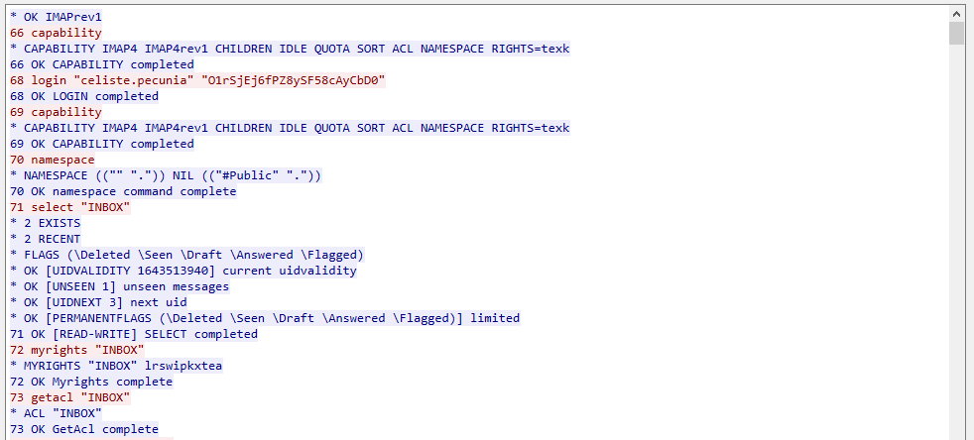
WireShark
This is the stream of network traffic that contains the event/packet we found in our search.
The colors indicate if the data was sent or received.
We need to scroll a bit to get to the data we’re looking for.

Slide 49
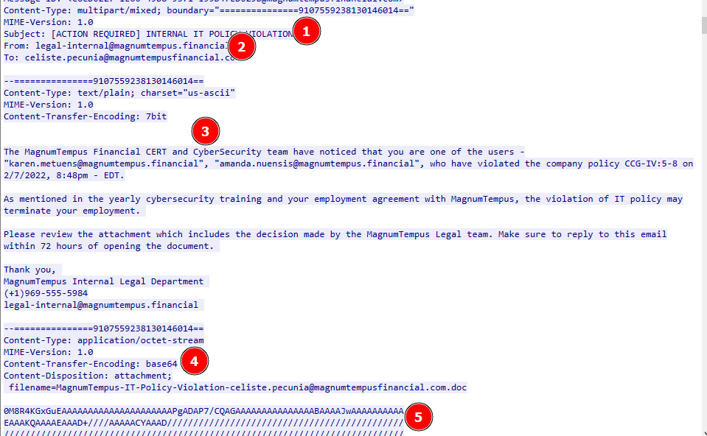
WireShark
In #1 and #2 we see the subject and from we determined earlier.
In #3, we see what appears to be the email contents (in plaintext!)
This is concerning as this means emails are going over the wire unencrypted!
In #4 and #5 we see the attachment - the filename matches what we expected to see.
It’s important to recognize that the item is encoded in Base64. This is a relatively easy encoding and can be reversed!

Slide 50
What’s next?
Image Source: https://commons.wikimedia.org/wiki/File:Question_Mark_Icon.png

Slide 51
What’s Next?
At this point, we could dive further and investigate the attachment, recreate it and find the macros included.
However, this might be a good point to stop and allow the next team to proceed with their investigation.

Slide 52
Check our Notes
Image Source: https://www.pexels.com/photo/black-laptop-computer-beside-white-steno-notebook-2034373/
Notes:
Welllllll …… Looking at our NOTES, we see that…

Slide 53
THREAT HUNTER PLAYBOOK
Playbook Title: Detecting Enterprise Macro Activity from Emails
Mitre Tactic: T1566, Phishing
Mitre Sub Technique: T1566.001, Spearphishing Attachment
Hypothesis: Employees are targeted with malicious documents with VBA Macro Code and some employees will open the documents and detonate the payload
Proposed Detection Query: index IN (zeek,sysmon) (.doc OR .xls OR .docx OR .xlsx) (TrustRecords) AND NOT (files.magnumtempusfinancial.com)
Simulation Details: NONE
Hunter Limitations/Observation Notes: During several portions of the hunt, we discovered that there were log sources that were not properly parsed, which made finding details difficult.
Hunt Findings: Three users downloaded the malicious document, two users appear to have been affected by the payload.

Slide 54
THANK YOU!
join the conversation
https://discord.blueteamvillage.org

